Slide 1



RW models of associative social learning

Slide 2


Social learning tasks
SLT: Paradigm and computational model that tests the speed (learning rate) of basic associative social learning.
a) Selective social learning (e.g. from experts)
b) Imitation learning
c) Mindreading
https://research.sc/participant/login/183183/publicid
Notes:
Log in with 1-10 number

Slide 3



Trial
?
Correct!/
Try again
TRIAL
ADVICE
RESPONSE
FEEDBACK
X was correct!
Outputs: Accuracy, RT, Learning rate parameters (alpha, beta, zeta)
Notes:
Two rocks presented repeatedly, red and yellow. The p of each being correct changed according to schedules:
Two things to learn: value of red vs yellow rock, i.e p of success
Value of advice – is the alien correct or incorrect.

Slide 4
TUESDAY

Slide 5
MATLAB
https://github.com/alirybicki/CSC_SLT
All code adapted from the open-source software package TAPAS (http://www.translationalneuromodeling.org/tapas).
Notes:
Redownload script .m file and data folder – gorilla data

Slide 6
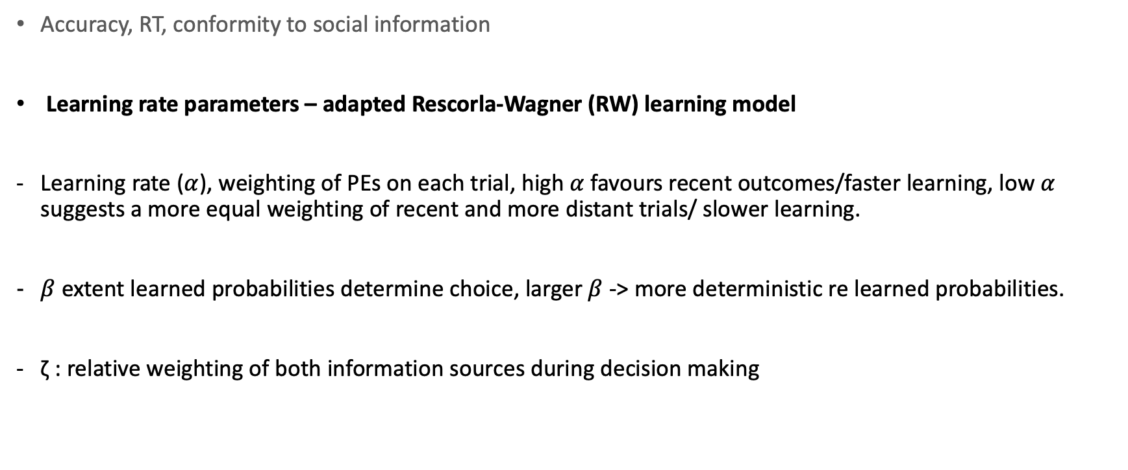
Measures
Accuracy, RT, conformity to social information
Learning rate parameters – adapted Rescorla-Wagner (RW) learning model
Learning rate ($α$), weighting of PEs on each trial, high $α$ favours recent outcomes/faster learning, low $α$ suggests a more equal weighting of recent and more distant trials/ slower learning.
$β$extent learned probabilities determine choice, larger $β$ -> more deterministic re learned probabilities.
ζ : relative weighting of both information sources during decision making

Slide 7
Modelling social learning
Perceptual model:
the states or values that probabilistically determine observed responses.
E.g. Bayesian generative model of the states of an agent's environment
(Hierarchical Gaussian Filter (HGF))
or a reinforcement learning (like Rescorla-Wagner (RW)).
Observation model:
describes how states/values of the perceptual model map onto responses.
E.g. softmax, unit-square sigmoid decision model.
Optimixation algorithm:
determine the maximum-a-posteriori (MAP) estimates of the parameters of both perceptual and decision models.
log-joint of data and parameters, given the models.
Notes:
Perceptual and observation models have to be chosen so that they are compatible, while the
choice of optimization algorithm is independent.
% be found there.
unnormalized log-posterior of all perceptual and observation parameters, given the data and the perceptual and observation models.

Slide 8
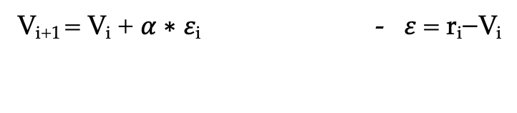
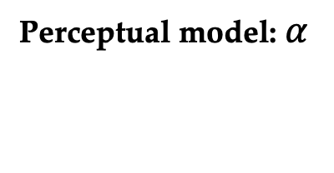
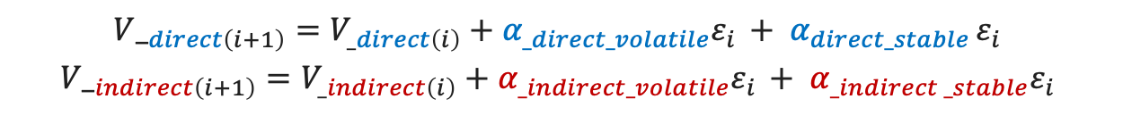
Rescorla-Wagner (RW) learning model
Perceptual model: $α$
V_{i+1} = V_{i} + $α$∗ 𝜀_{i} - 𝜀 = r_{i}−V_{i}
$${{V_}_{direct\left(i+1\right)}=V_{_direct\left(i\right)}+{α_{_direct_volatile}ε}_{i }+ α_{direct_stable }ε_{i}}_{ }$$
$${{V_}_{indirect\left(i+1\right)}=V_{_indirect\left(i\right)}+{α_{_indirect_volatile}ε}_{i }+ α_{_indirect _stable}ε_{i}}_{ }$$
V_{i} : value of stimulus at trial t, reflects expectation of a reward
r_{i} : actual reward received on trial t
α is the learning rate
Value V is updated based on the prediction error: difference between the received reward r and the expectation V.
Learning rate α weights prediction error.

Slide 9
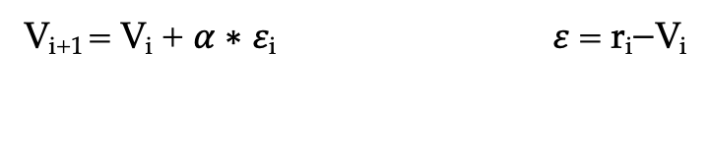
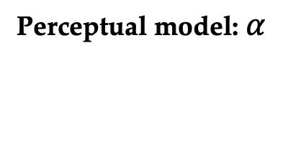
Rescorla-Wagner (RW) learning model
Perceptual model: $α$
V_{i+1} = V_{i} + $α$∗ 𝜀_{i} 𝜀 = r_{i}−V_{i}
est = tapas_fitModel_vol_social(response, [inputs_reward inputs_groupcorrectness], volatile, inputs_advice, condition)
Inputs:
inputs_reward = actual correct choice
response = choice
response_group2 = conformity to group choice
inputs_advice = social (alien) choice
inputs_groupcorrectness = social correct
condition = condition (optional)
Fits tapas_rw_social_reward_vol.m

Slide 10
Rescorla-Wagner (RW) learning model
Perceptual model: $α$
V_{i+1} = V_{i} + $α$∗ 𝜀_{i} 𝜀 = r_{i}−V_{i}
est = tapas_fitModel_vol_social(response, [inputs_reward inputs_groupcorrectness], volatile, inputs_advice, condition)
Outputs:
est.p_prc: Maximum-a-posteriori estimates of perceptual parameters (alpha)
est.p_obs: Maximum-a-posteriori estimates of observation parameters (beta, zeta)
est.traj: Trajectories of the environmental states tracked by the perceptual model

Slide 11
Rescorla-Wagner (RW) learning model
Perceptual model: $α$
V_{i+1} = V_{i} + $α$∗ 𝜀_{i} 𝜀 = r_{i}−V_{i}

Slide 12
Rescorla-Wagner (RW) learning model
Perceptual model: $α$
V_{i+1} = V_{i} + $α$∗ 𝜀_{i} 𝜀 = r_{i}−V_{i}
tapas_rw_social_reward_vol.m
% Prediction error
da_r(k) = u_r(k)-v_r(k-1);
% Value update
v_r(k) = v_r(k-1)+al*da_r(k);

Slide 13
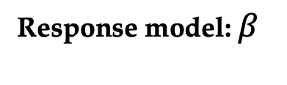
Rescorla-Wagner (RW) learning model
Response model: $β$
$P(y_{\left(i_{1}\right)}=1 |\left|vB_{(i+1)}\right)= \frac{{vB_{(i+1)}}^{β}}{{vB_{(i+1)}}^{β}+ {(1−vB_{\left(i+1\right)})}^{β}}$
% use learned value of utility of advice to weight the advice that was provided on each trial
x_a(j,1) = 1-x_a(j,1);
b = ze1.*x_a + (1-ze1).*x_r;
% Calculate log-probabilities
y = y.*ze2.*log(b./(1-b)) +log((1-b).^ze2 ./((1-b).^ze2 +b.^ze2));
ze1 = beta!

Slide 14
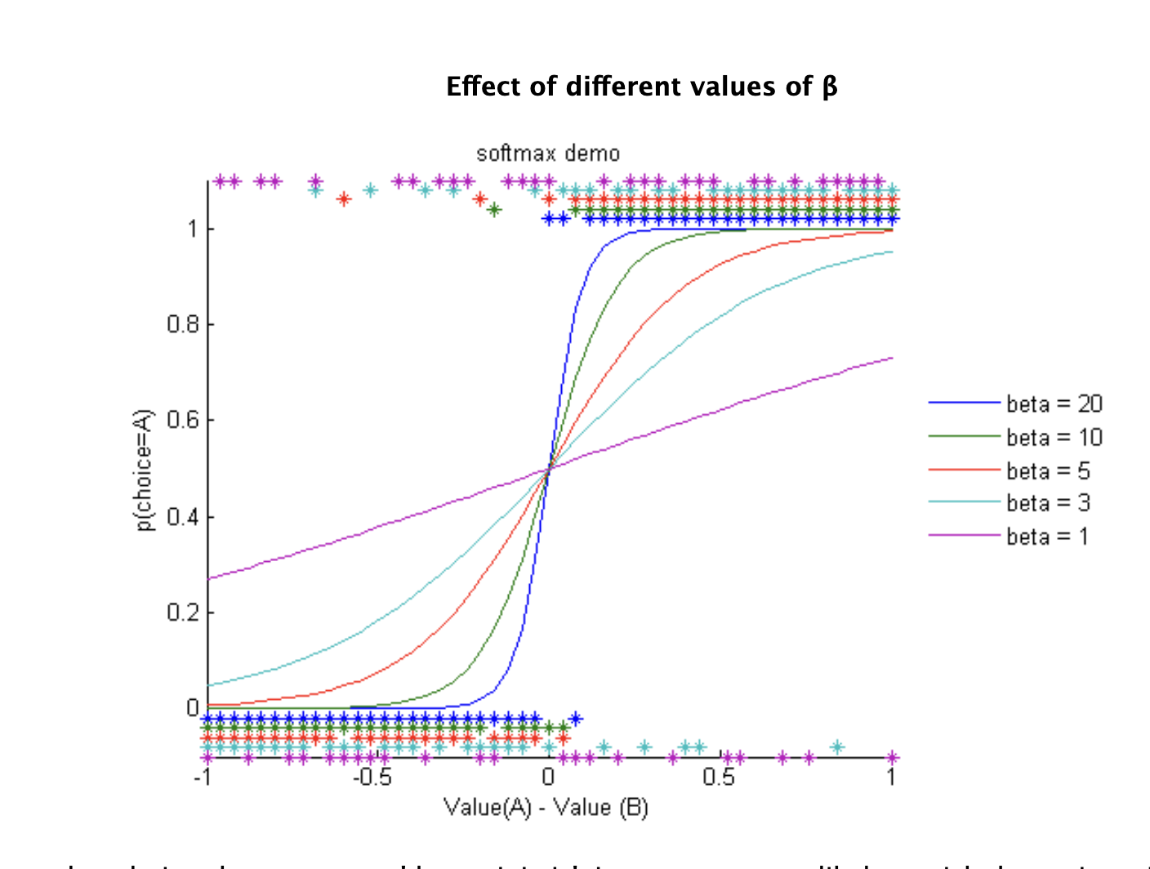
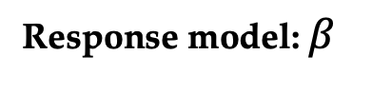
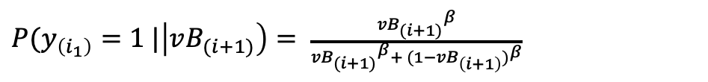
Rescorla-Wagner (RW) learning model
Response model: $β$
$P(y_{\left(i_{1}\right)}=1 |\left|vB_{(i+1)}\right)= \frac{{vB_{(i+1)}}^{β}}{{vB_{(i+1)}}^{β}+ {(1−vB_{\left(i+1\right)})}^{β}}$
A = value
B = 1- A value
http://www.hannekedenouden.ruhosting.nl/RLtutorial/html/SoftMax.html
Notes:
inverse temperature parameter β controls the extent to which action value differences influence choice.
translate the learned values into a choice (0/1)
Free parameter beta –‘inverse temperature’, the higher beta, the more deterministic choices are, less random, i.e. usually go with higher value option, less exploration.
A larger β means that choices become more 'deterministic', i.e. you are more likely to pick the option with the highest value
When β is smaller, you become more 'exploratory', i.e. you are more likely to pick the other option now and again as well.

Slide 15
Rescorla-Wagner (RW) learning model
Model fitting: quasi-Newton optimization.
quasinewton_optim_config.m.
Maximixes log-joint posterior density over all parameters given the data and the generative model.
α values were estimated in logit space ( tapas_logit.m): logistic sigmoid transformation of native space
(tapas_logit(x) = ln(x/(1-x)); x = 1/(1 + exp(-tapas_logit(x)))).
Notes:
In optimization, quasi-Newton methods for finding local maxima – of log- joint posterior density for all parameters
MAP
-
Maximum a Posteriori - Bayesian-based approach to estimating a distribution and model parameters that best explain an observed dataset.
Logit space- proability 0-1 for normal values

Slide 16
Rescorla-Wagner (RW) learning model
Initial values and priors:
Prior values: 0.5
α: tapas_logit (0.2, 1), with a variance of 1.
Β - log (48), with a variance of 1
ζ - 0 with a variance of 10² (logit space ) - equal weighting for information derived from primary and secondary learning ( = 0.5).
Notes:
Alpha: Uninformative prior, allowing for individual differences in learning rate
Initial values: logit (0.5, 1), with a variance of 1. Allowed to vary, to allow for inter-individual differences in prior preferences for the extent to which individual would conform.
Tapas_RW_social_rew_config – line 64 – fix or unfix initial values

Slide 17
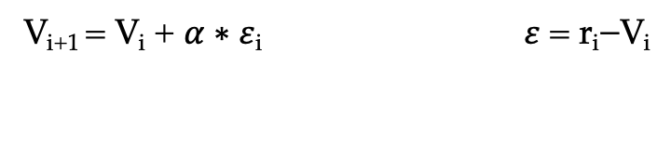
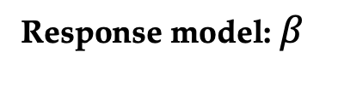
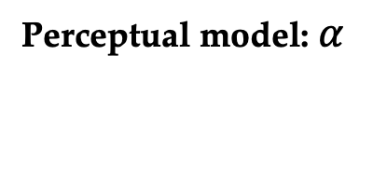

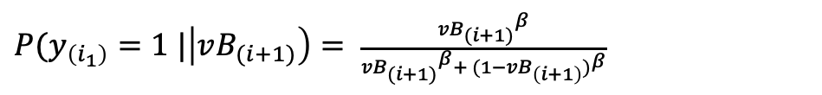
Rescorla-Wagner (RW) learning model
Perceptual model: $α$
V_{i+1} = V_{i} + $α$∗ 𝜀_{i} 𝜀 = r_{i}−V_{i}
$${{V_}_{direct\left(i+1\right)}=V_{_direct\left(i\right)}+{α_{_direct_volatile}ε}_{i }+ α_{direct_stable }ε_{i}}_{ }$$
$${{V_}_{indirect\left(i+1\right)}=V_{_indirect\left(i\right)}+{α_{_indirect_volatile}ε}_{i }+ α_{_indirect _stable}ε_{i}}_{ }$$
Response model: $β$
$P(y_{\left(i_{1}\right)}=1 |\left|vB_{(i+1)}\right)= \frac{{vB_{(i+1)}}^{β}}{{vB_{(i+1)}}^{β}+ {(1−vB_{\left(i+1\right)})}^{β}}$
Notes:
OUTPUT:
% est.u Input to agent (i.e., the inputs array from the arguments)
% est.y Observed responses (i.e., the responses array from the arguments)
% est.irr Index numbers of irregular trials
% est.ign Index numbers of ignored trials
% est.c_prc Configuration settings for the chosen perceptual model
% (see the configuration file of that model for details)
% est.c_obs Configuration settings for the chosen observation model
% (see the configuration file of that model for details)
% est.c_opt Configuration settings for the chosen optimization algorithm
% (see the configuration file of that algorithm for details)
% est.optim A place where information on the optimization results is stored
% (e.g., measures of model quality like LME, AIC, BIC, and posterior
% parameter correlation)
% est.p_prc Maximum-a-posteriori estimates of perceptual parameters
% (see the configuration file of your chosen perceptual model for details)
% est.p_obs Maximum-a-posteriori estimates of observation parameters
% (see the configuration file of your chosen observation model for details)
% est.traj: Trajectories of the environmental states tracked by the perceptual model
% (see the configuration file of that model for details)
%

Slide 18
WEDNESDAY
Model comparison
Model validation

Slide 19
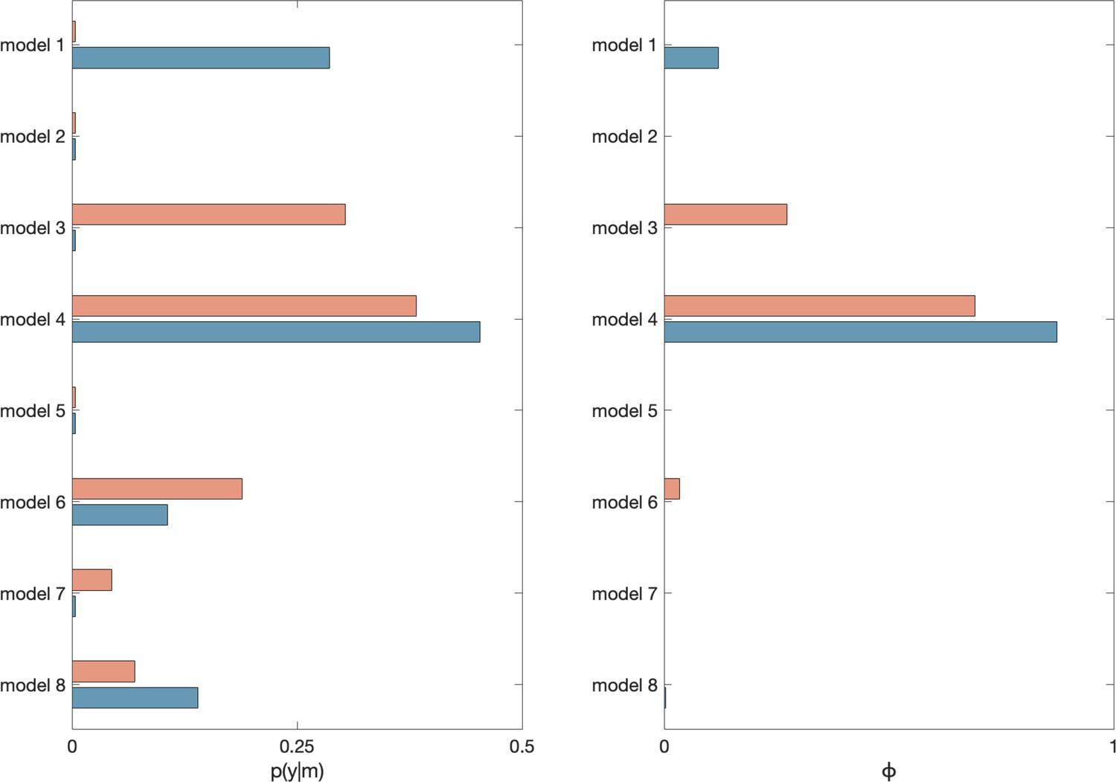
Model Comparison
BMS using the VBA toolbox (Stephan et al., 2009).
Random effects group BMS computes an approximation of the model evidence relative to the other models: probability of the data y given a model m, p(y|m), log model evidence approximated with F values.
p(y|m): Posterior model probability Posterior probability that a model has generated the observed data, relative to other models
ϕ: Exceedance probability
Exceedance probability/ likelihood that a given model is more likely than other included models in the set.

Slide 20
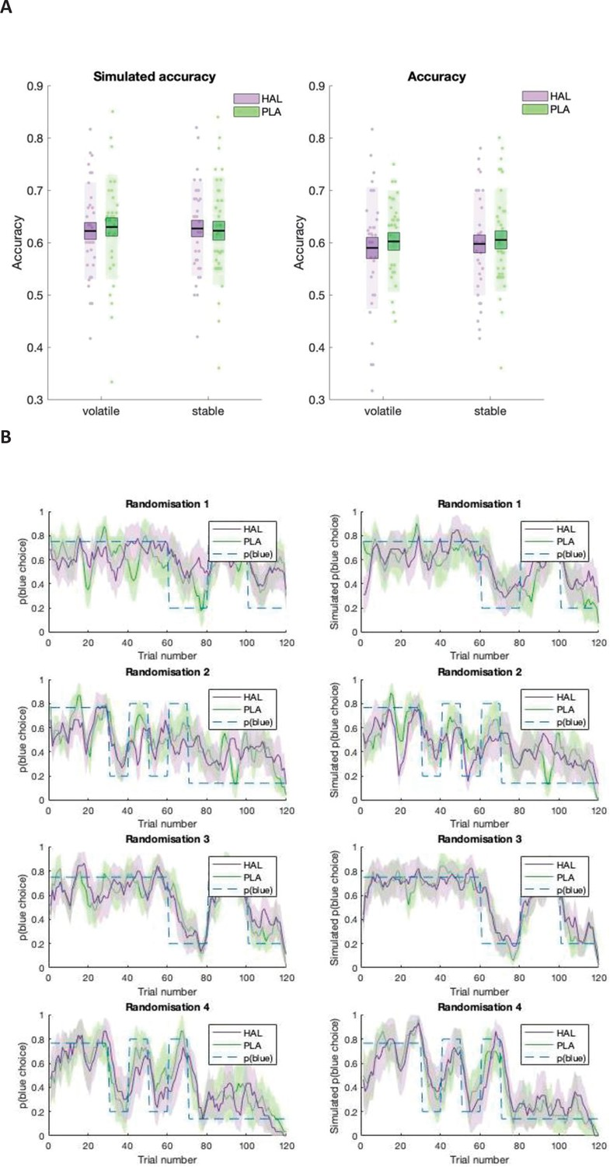
Model validation
Simulate response data using estimated model parameter values (tapas_simModel.m).
Simulate choice data and compare with actual choice data
Notes:
Can chosen model accurately described participant behaviour?
Simulated response data for each participant using estimated model parameter values (tapas_simModel.m).
A) Model simulations (left) and participant response data (right).. (B) Participant data (left) juxtaposed against model simulations (right). Running average, across five trials of blue choices for probabilistic randomisation schedules 1–4. Shaded region: standard error of the mean.

Slide 21
Model validation
Simulate response data using estimated model parameter values (tapas_simModel.m).
Simulate choice data and compare with actual choice data – e.g. accuracy
Notes:
Can chosen model accurately described participant behaviour?
Simulated response data for each participant using estimated model parameter values (tapas_simModel.m).
Mean accuracy is displayed separately for volatile and stable environmental phases, under haloperidol (HAL; purple) and placebo (PLA; green). Boxes: standard error of the mean; shaded region: standard deviation; individual datapoints are displayed

Slide 22
Model validation
Can we ‘recover’ parameters?
Estimate model parameters (α and β) for a subject, simulate response data based on these parameters (tapas_simModel.m ).
Estimate model parameters again from this data.
All recovered parameters should correlate significantly with estimated parameters

